Slide 1
VR Storytelling
History and Introduction
Presented by Steven King

Slide 2
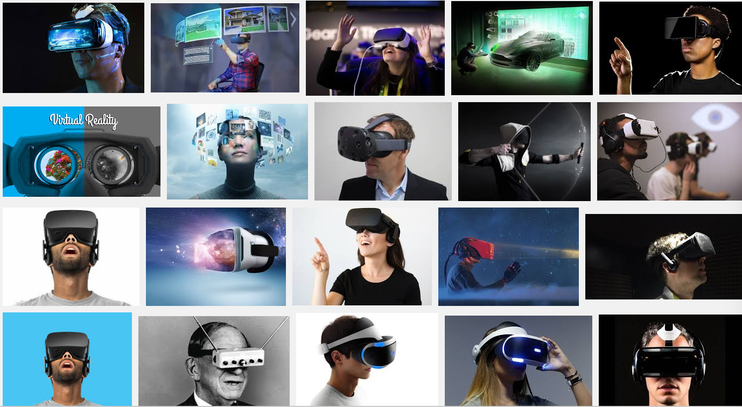
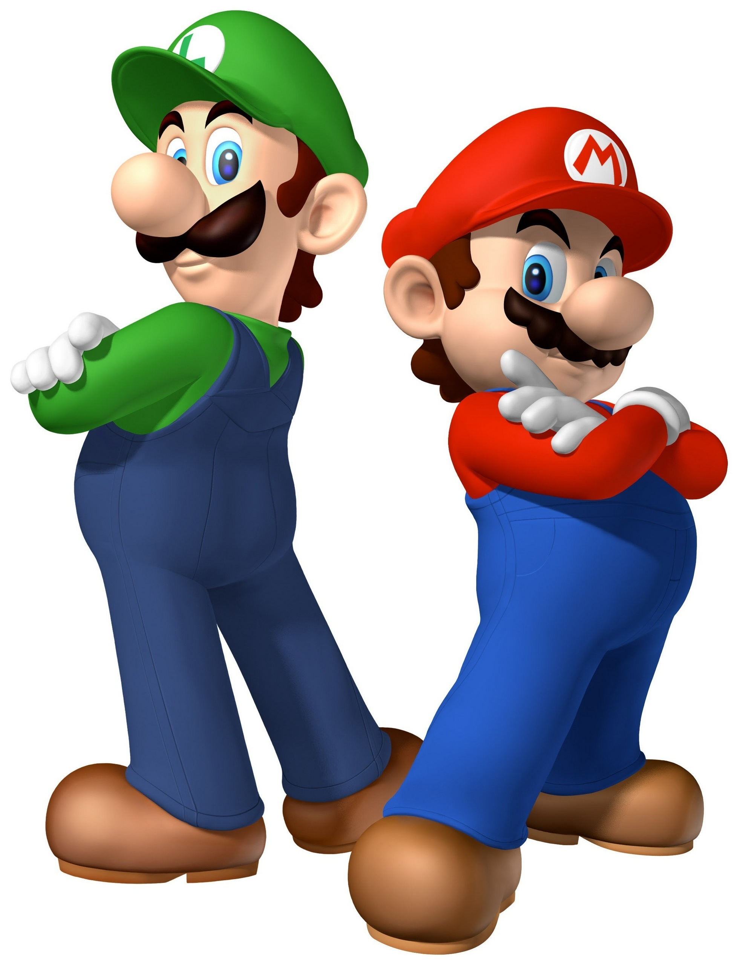
The Future is from the Past
Google Image Search for Virtual Reality

Slide 3
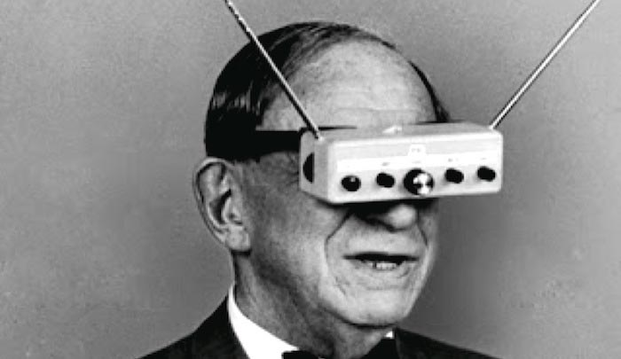
A Brief
History
Quick Overview

Slide 4
History
“The ultimate display would, of course, be a room within which the computer can control the existence of matter. A chair displayed in such a room would be good enough to sit in. Handcuffs displayed in such a room would be confining, and a bullet displayed in such a room would be fatal”.
Ivan Sutherland, 1965

Slide 5
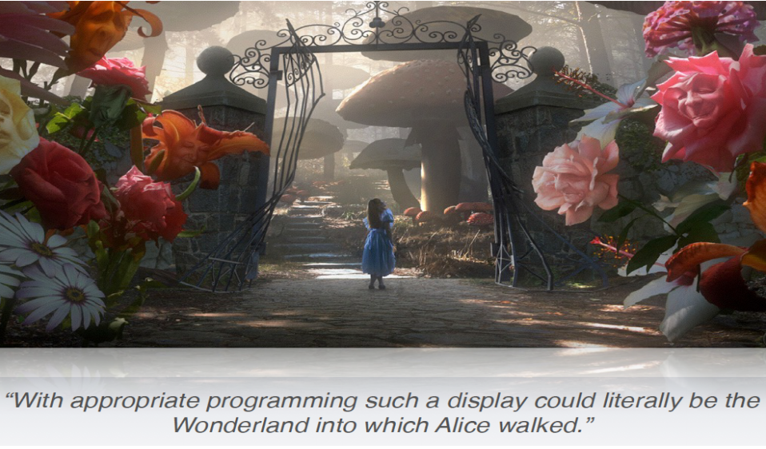
History
“The ultimate display would, of course, be a room within which the computer can control the existence of matter. A chair displayed in such a room would be good enough to sit in. Handcuffs displayed in such a room would be confining, and a bullet displayed in such a room would be fatal”.
Ivan Sutherland, 1965

Slide 6
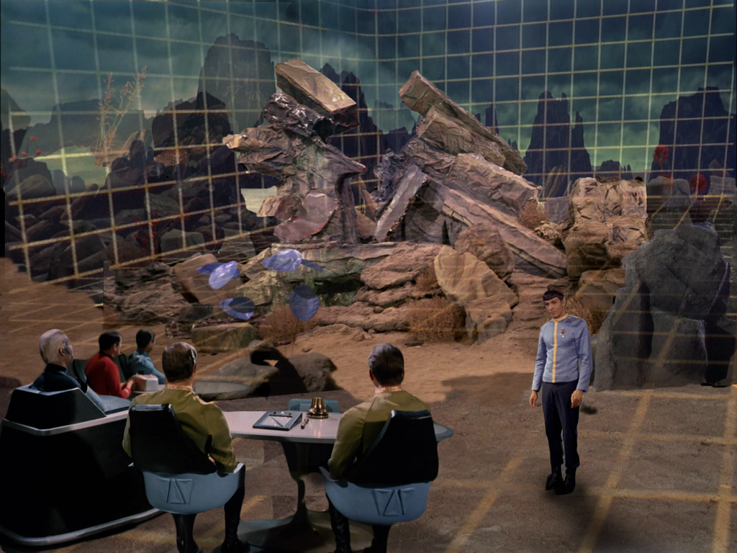
Back to the Future?
First shown in 1977

Slide 7
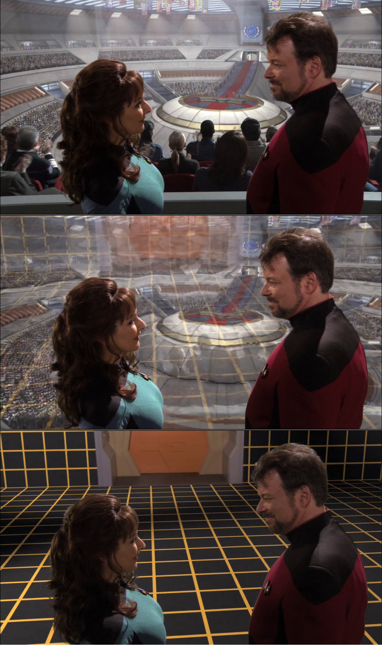
The Future is from the Past
1990
https://www.youtube.com/watch?v=oZwtVz7z0wM

Slide 8
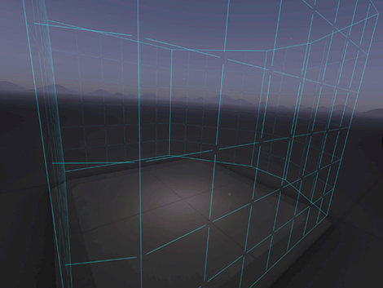
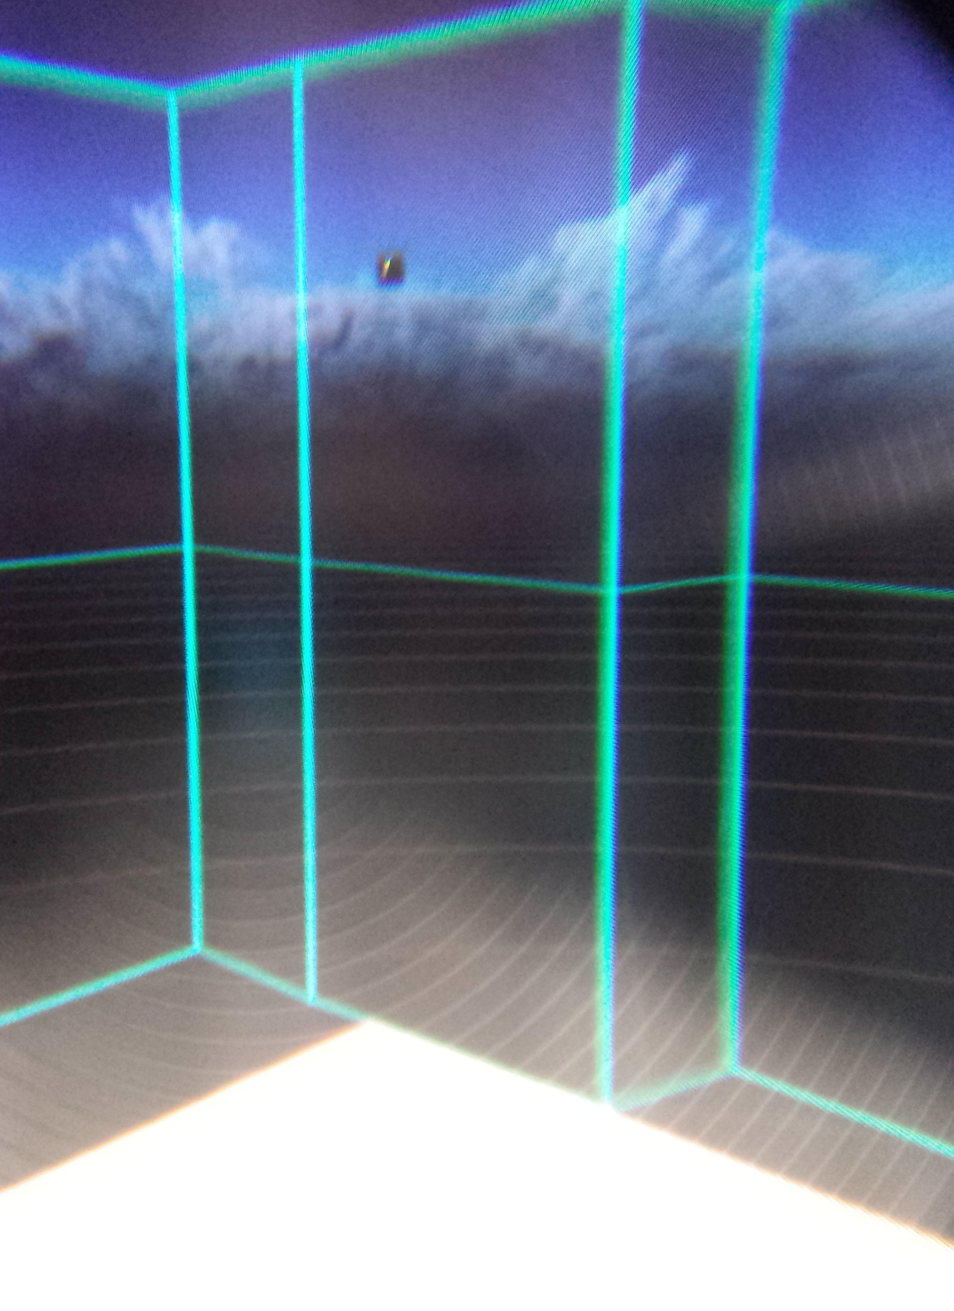
Like the movies
HTC Vive Chaperon

Slide 9
VR History
1919 Radio
1937 TV Broadcast
1944 Color TV
1988 CD-ROM
1994 Internet
1999 Internet Phone

Slide 10
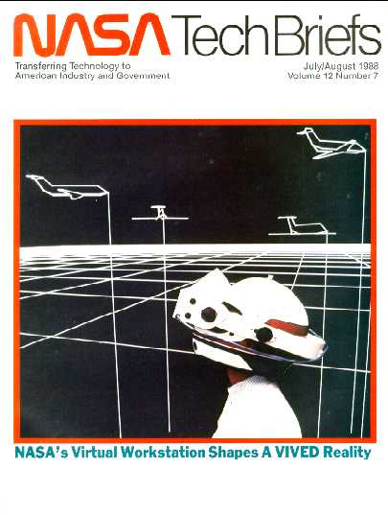
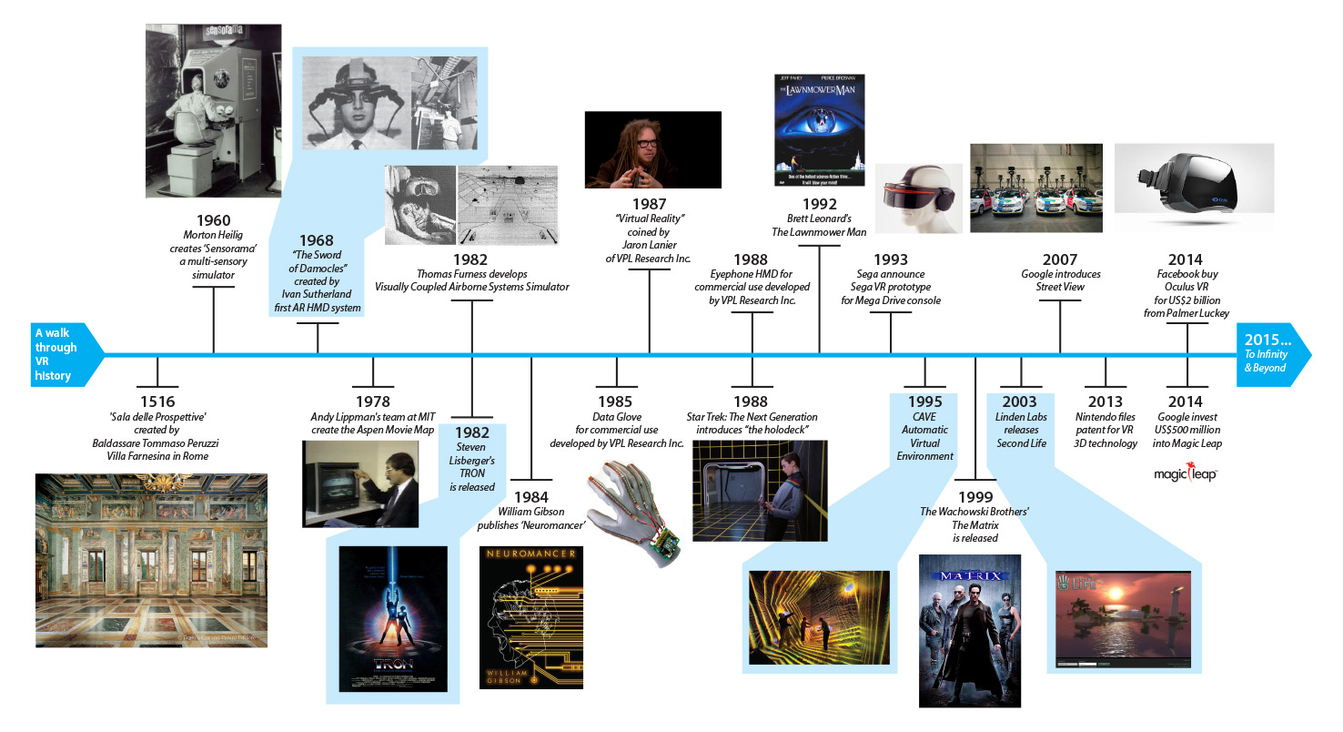
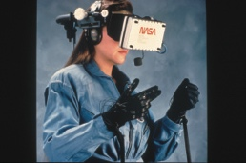
Brief
History
1985

Slide 11
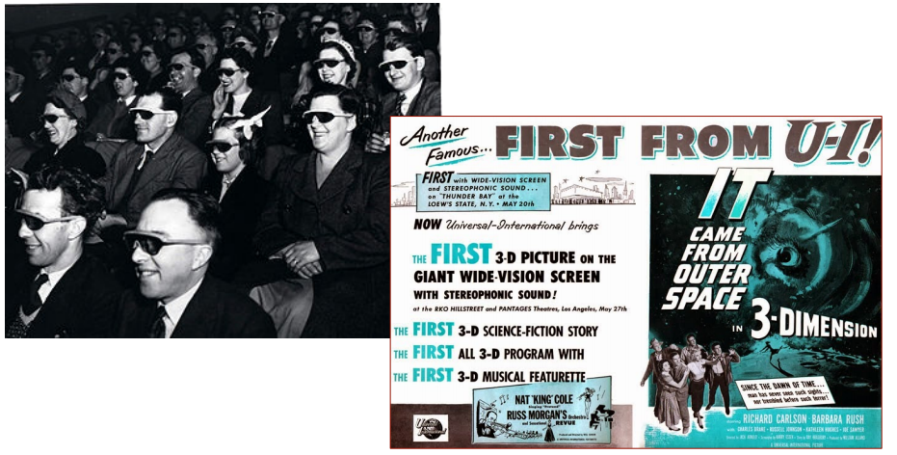
Brief
History
1935

Slide 12
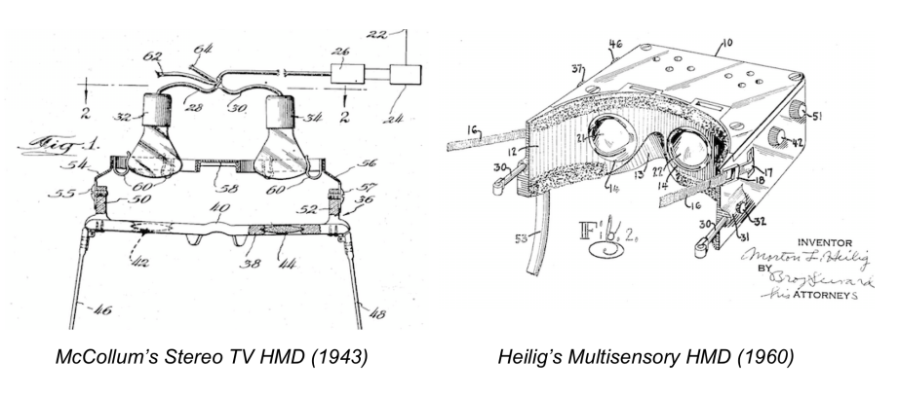
Brief
History
1943, 1960
Patent Applications

Slide 13
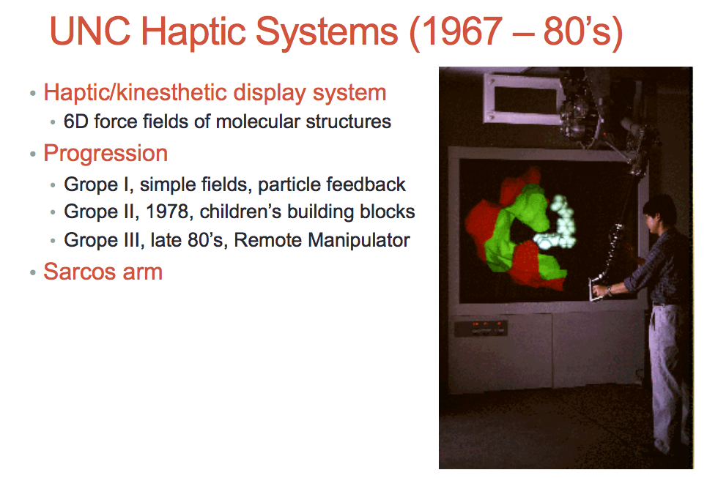
Brief
History
Go Tarheels!
Slide from
Mark Billinghurst
University of Australia

Slide 14
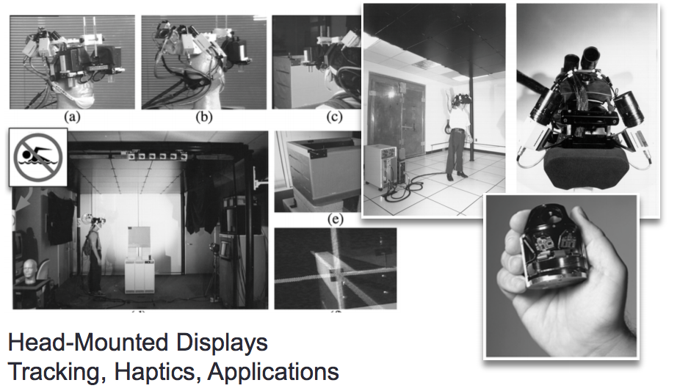
Brief
History
Go Tarheels!
UNC Research Continued in 80-90’s

Slide 15
Brief
History
1985

Slide 16
STOP
What is Virtual Reality
The computer-generated simulation of a three-dimensional image or environment that can be interacted with in a seemingly real or physical way by a person using special electronic equipment, such as a helmet with a screen inside or gloves fitted with sensors.

Slide 17
Major Characteristics of Virtual Reality
3D Stereoscopic Display
Field of View Display
Head Tracking
https://www.youtube.com/watch?v=FPcbBJbGhmk

Slide 18
VR Experience
“It’s So Real
https://www.youtube.com/watch?v=pAC5SeNH8jw
https://www.youtube.com/watch?v=ji1c16SghXM

Slide 19
VR Experience
Is Presemce
Presence is the key to defining VR in terms of experience
• Presence is defined as the sense of being in an environment
• Telepresence is defined as the experience of presence in an environment by means of a communication medium.
• A “virtual reality” is defined as a real or simulated environment
in which a perceiver experiences telepresence.

Slide 20
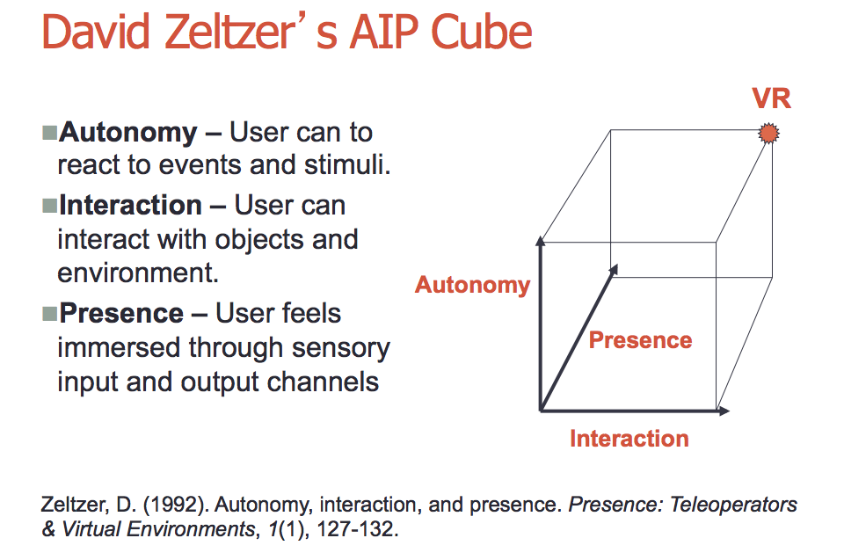
Behind VR

Slide 21
How Real can we get?
More than one sense enhanced with technology provides immersion.
https://www.youtube.com/watch?v=aTtfAQEeAJI

Slide 22
VR vs
360 Video
The public (audience) does not understand the difference and DOES NOT CARE!
They see the device and say VR.
As professionals, we must separate the two.

Slide 23
Assignment
Putting into practice

